Slide 1


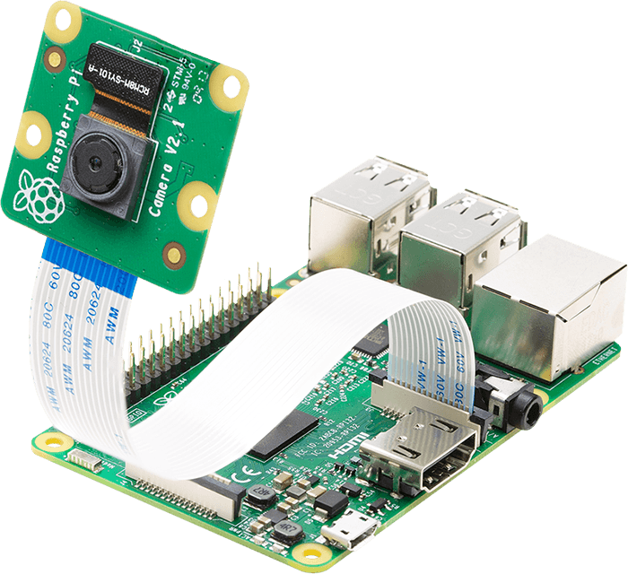
Development of iot-based solution for checking student attendance
Student 1: Nguyen Truong Thanh (1652557)
Student 2: Nguyen Anh Quan (1552310)
Supervise: PhD. Pham Hoang Anh
January 25th, 2021

Slide 2
Contents
Introduction
Methodology
Evaluation and Testing
Conclusion

Slide 3
Introduction
Attendance marking
Traditionally marking
Fingerprint
RFID Card
Face Recognition

Slide 4


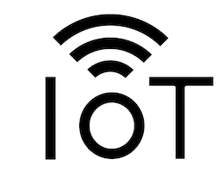
Technologies used

Slide 5
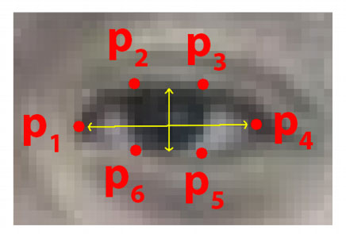
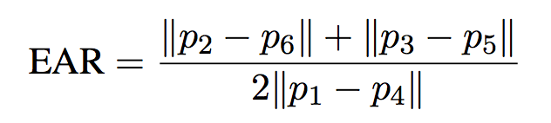
Eye aspect ratio (Ear)
Each eye is represented by 6 (x, y)-coordinates
There is a relation between the width and the height of these coordinates

Slide 6
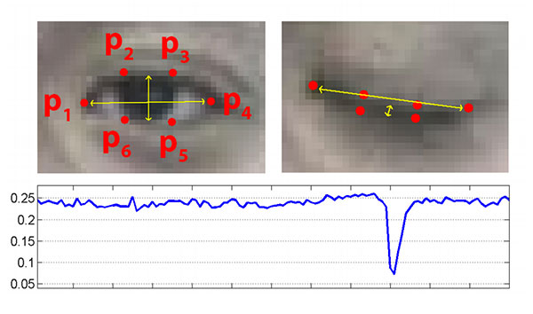

Slide 7
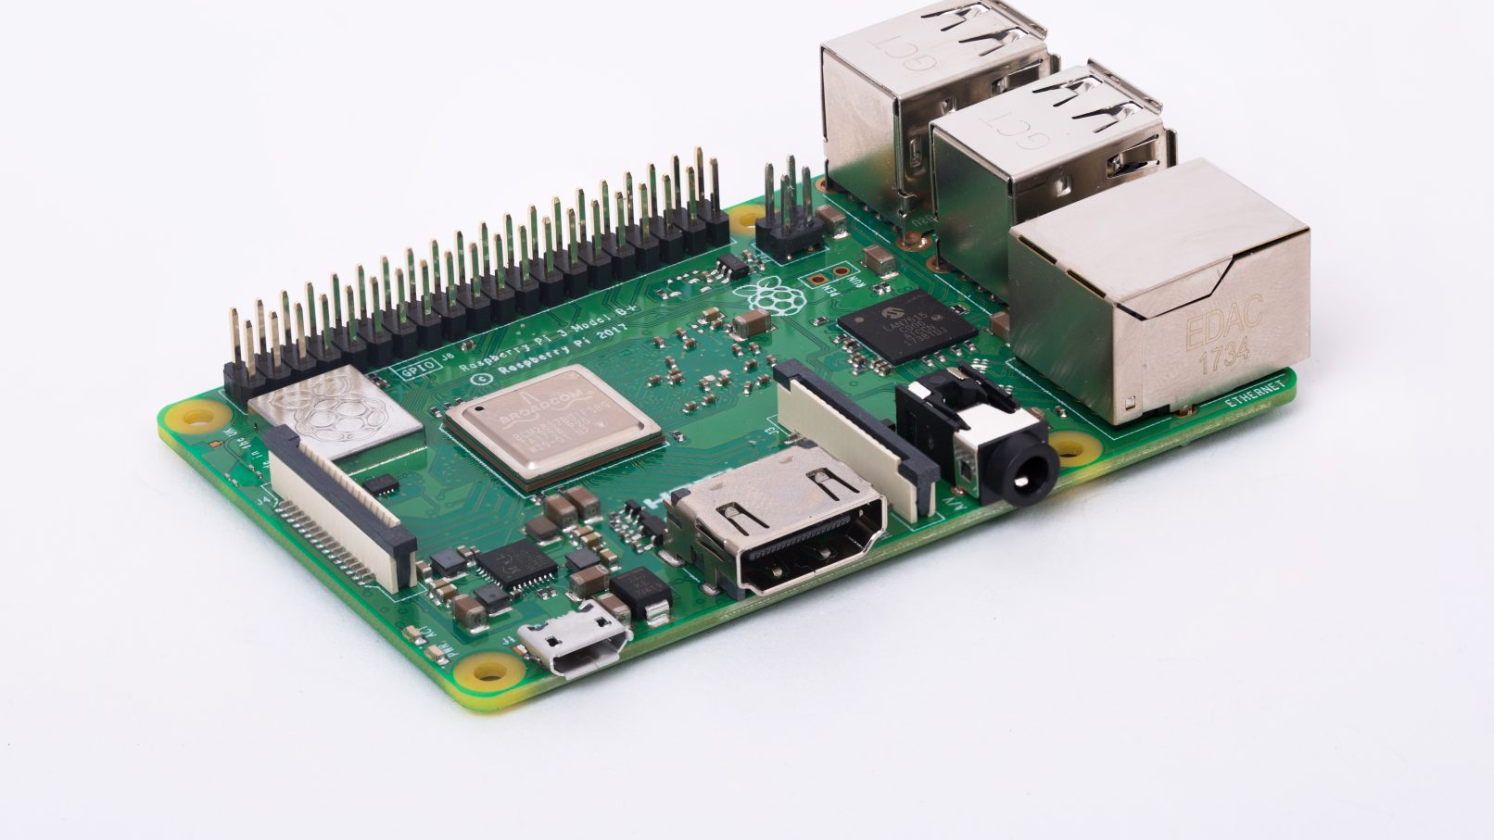
METHODOLOGY

Slide 8
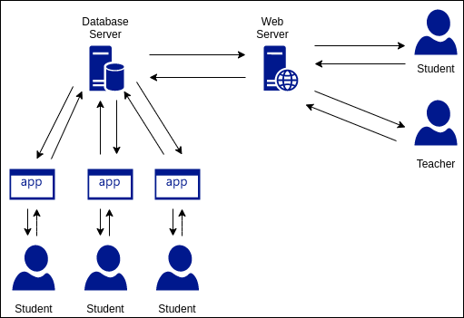
System overview

Slide 9
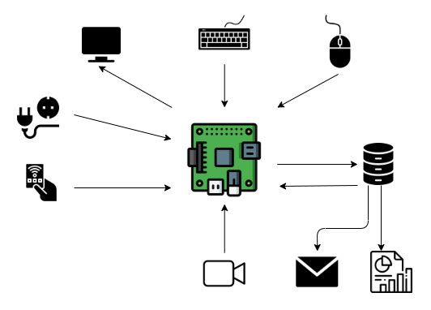
System Overview

Slide 10


Slide 11
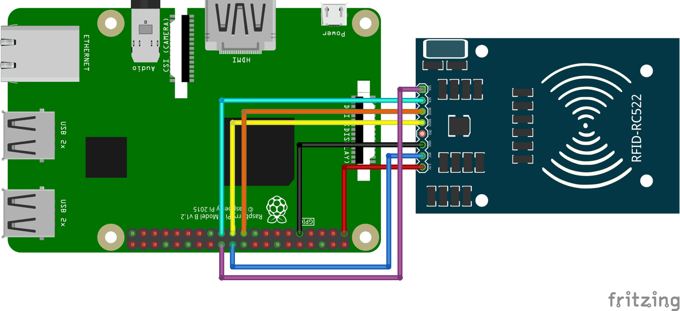

Slide 12
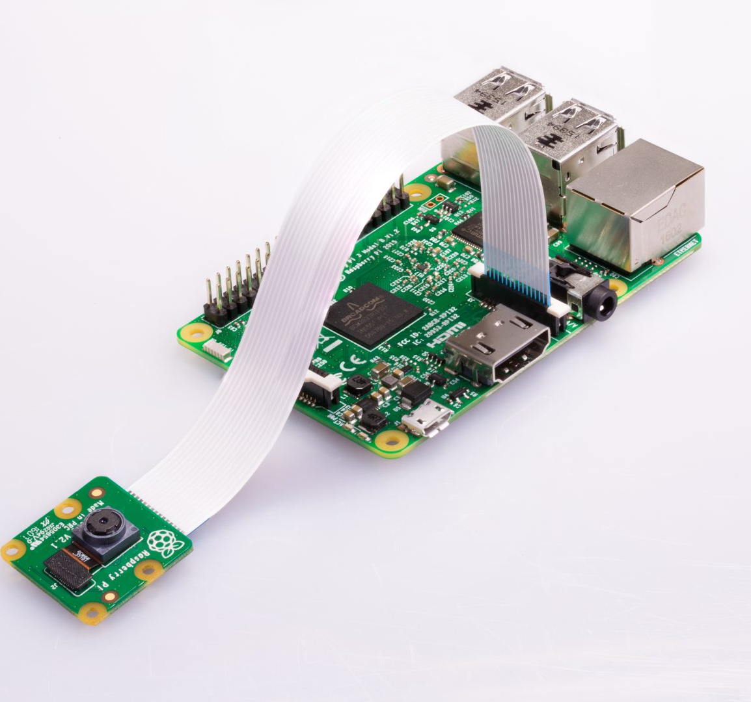
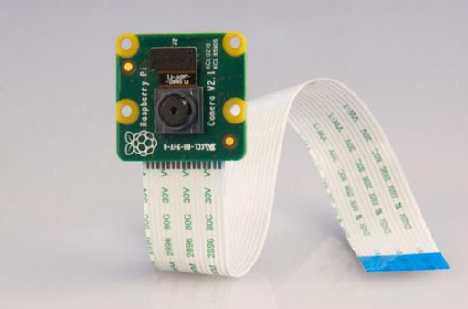

Slide 13

python app

Slide 14
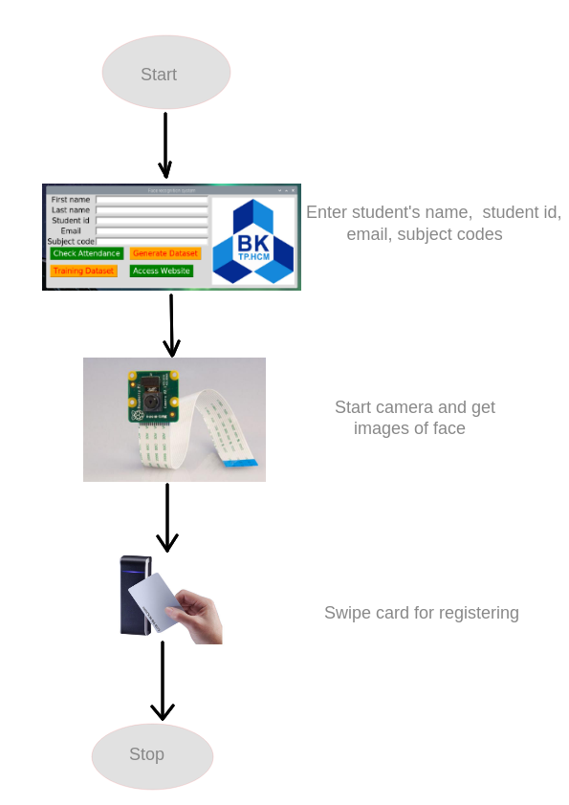
Register

Slide 15
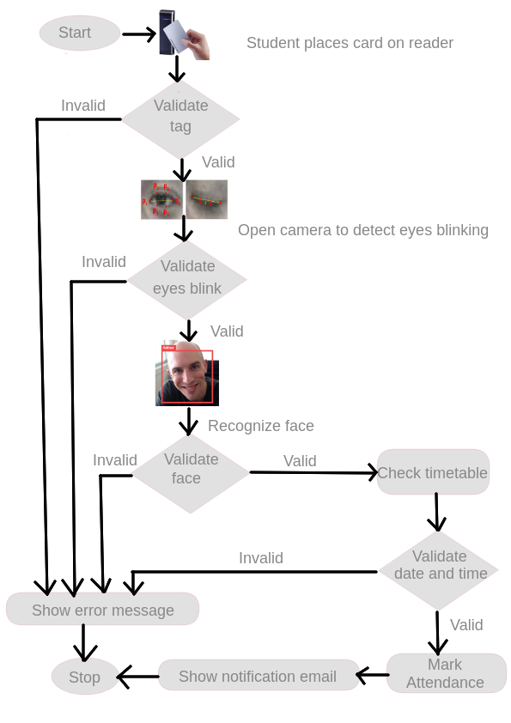
Marking attendance

Slide 16

Web app

Slide 17
Web app
Html, CSS, JavaScript, Ajax, Bootstrap, etc.
3 roles: admin, teacher, student
Data charts, search bar
Login, logout with session
Registration
Forgot password, confirm via email token

Slide 18
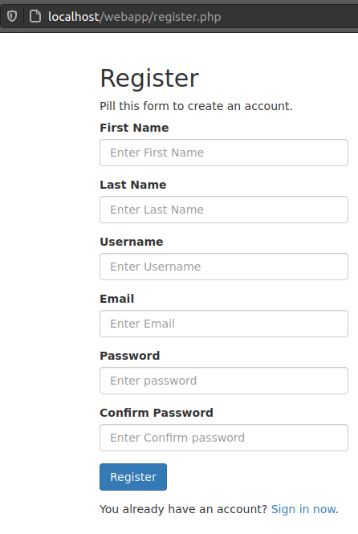
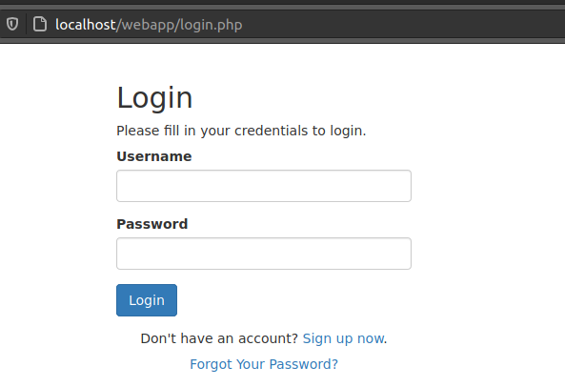
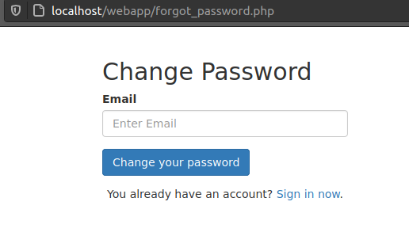

Slide 19
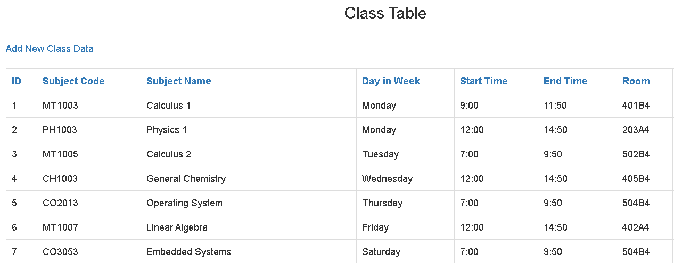
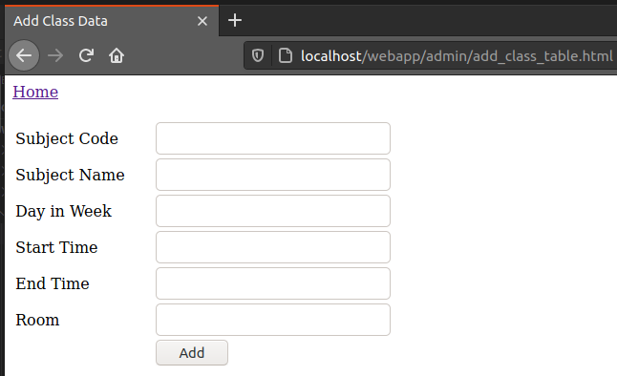
Admin

Slide 20
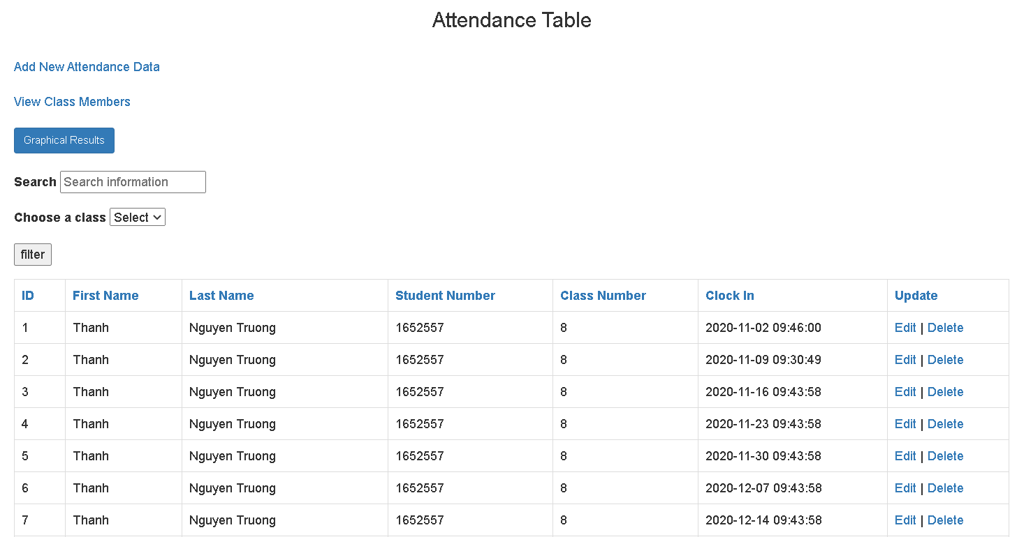
teacher

Slide 21
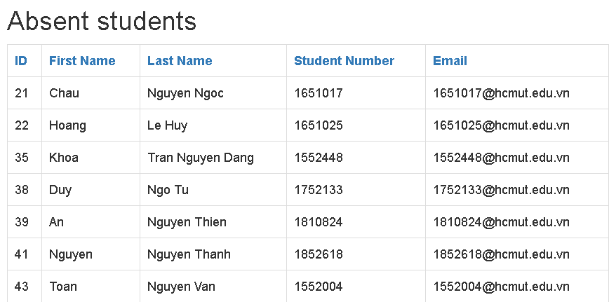
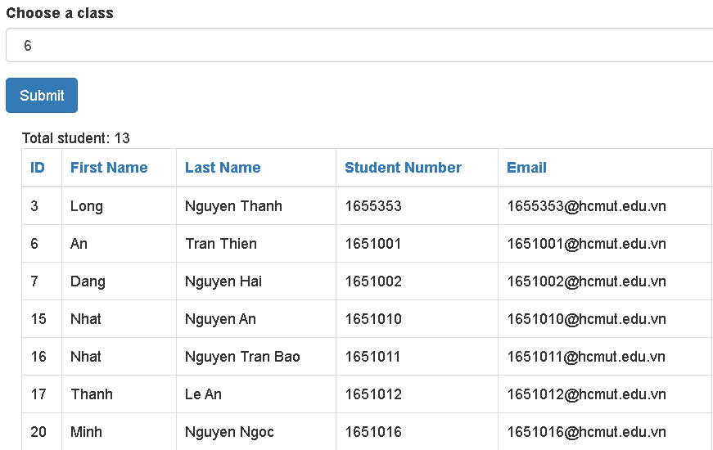
Teacher TOTAL STUDENT OF CLASS

Slide 22
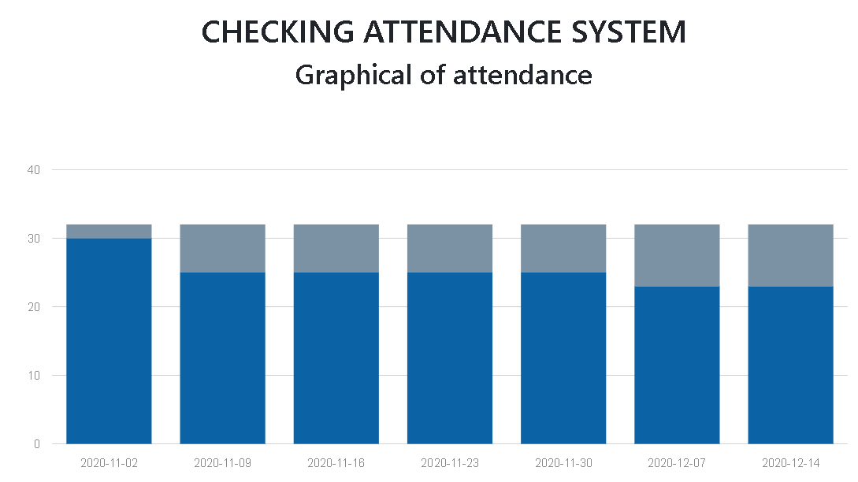
Attendance chart

Slide 23
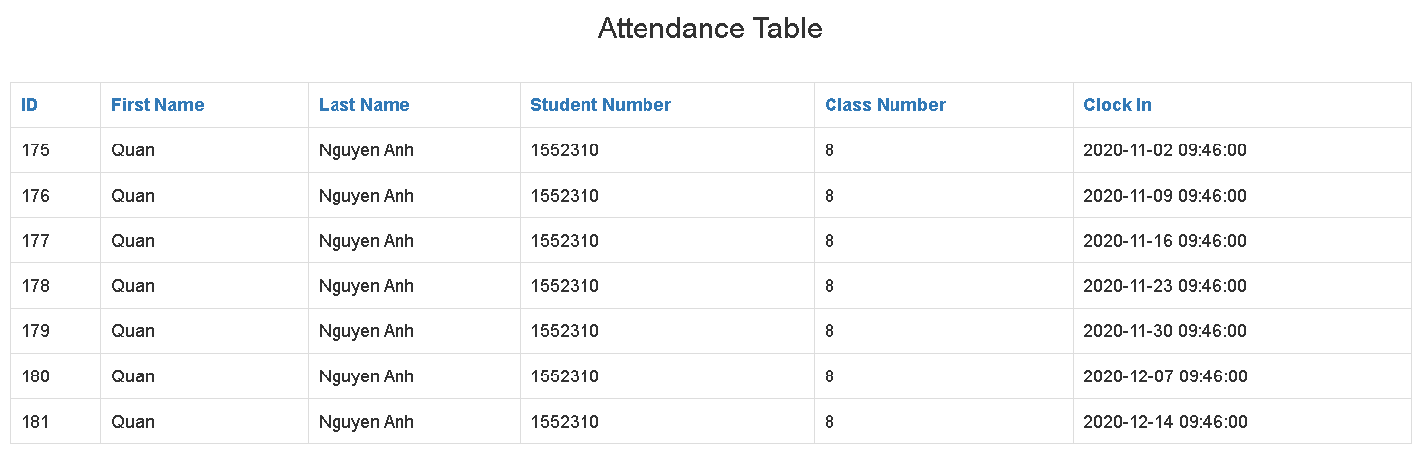
STUDENT

Slide 24
Evaluation and testing
Testing
Evaluation

Slide 25

testing
Test Case | Average time of 50 test cases (s) | Accuracy (%)
Register | 91.1 | \
Correct all | 58 | 94
Wrong timetable | 43.2 | 95
Other face in database | 35.2 | 92
Unknown face | 38.3 | 95
Unregistered card | 27.9 | 100
Fake image | 80.3 | 100

Slide 26

Evaluation

Slide 27
Evaluation
Advantages
The system is easy to setup
Have all a checking attendance system need
Have data chart
Low cost
Disadvantages
Timing constraint
Low capacity of RAM
User interface is not good

Slide 28
conclusion
Contributions
Future Works

Slide 29

Contributions
Give a solution to check student attendance using IoT devices.
Combine RFID and Facial recognition
Detect fake image of faces

Slide 30

Future work
Setup web server and database server to another hosting
Move the project to the stronger system
Use other methods to improve the efficiency of anti-spoofing to replace eye blink detection
Create a better user interface
Improved code logic of the system

Slide 31

Thank you any question?

